Slide 1
IoT architecture, protocoles
RT0911
Master Réseaux-Télécoms
Hacène Fouchal

Slide 2
Contexte
Kevin Ashton a proposé le terme IoT en 1999.
Le concept : tout dispositif, tout capteur, tout logiciel dans tous les domaines sont interconnectés
Tout élément est accessible à distance
IoT= plateforme où des éléments sont connectés à Internet qui permettent une de collecter des données et de les échanger pour apprendre des autres (à l’image des humains).’

Slide 3

Contexte

Slide 4
Fonctionnement
Les dispositifs communiquent d’une façon sécurisée avec la plateforme IoT.
La platerfome IoT collete et combine les données venant de dispositifs et de plateformes et exécutent des analyses pour partager les informations les plus pertinentes pour répondre à une exigences applicative.

Slide 5
Architecture IoT
illustration
Infrastructure Cloud
Passerelles
Architecture IoT
Object
Infrastructure
réseau

Slide 6
Utilisation des IoT
5 domaines d’utilisation majeure des IoT :
Intelligence artificielle : la technologie IoT rend les objets plus intelligents grâce aux données, aux réseaux et algorithmes
Connectivité : devient opérationnelle pour des réseaux plus réduit dans mettre en cause l’efficacité
Capteurs : donne la raison d’être des IoT.
Interaction active entre éléments : Nouveau paradigme, on ajoute du service supplémentaire pour du contenu additionnel
Dispositifs : sont plus réduits, plus puissants, moins chers qui montrent l’efficacité à grande échelle des IoT

Slide 7
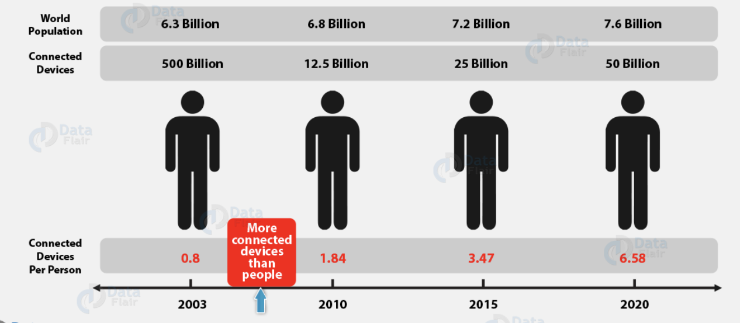
Historique-Perspectives

Slide 8
Applications
Santé : le suivi médical pour des cas chronique apporte des solutions pour aussi bien ls malades que les médecins
Energie : la réduction de la consommation est cruciale
Education : Aide les formateurs à illustrer les idées. Le suivi en est plussimplifié.
Etatique : les « smart city » deviennent courantes partout pour gérer la mobilité, la gestion de l’énergie, des transports, …

Slide 9
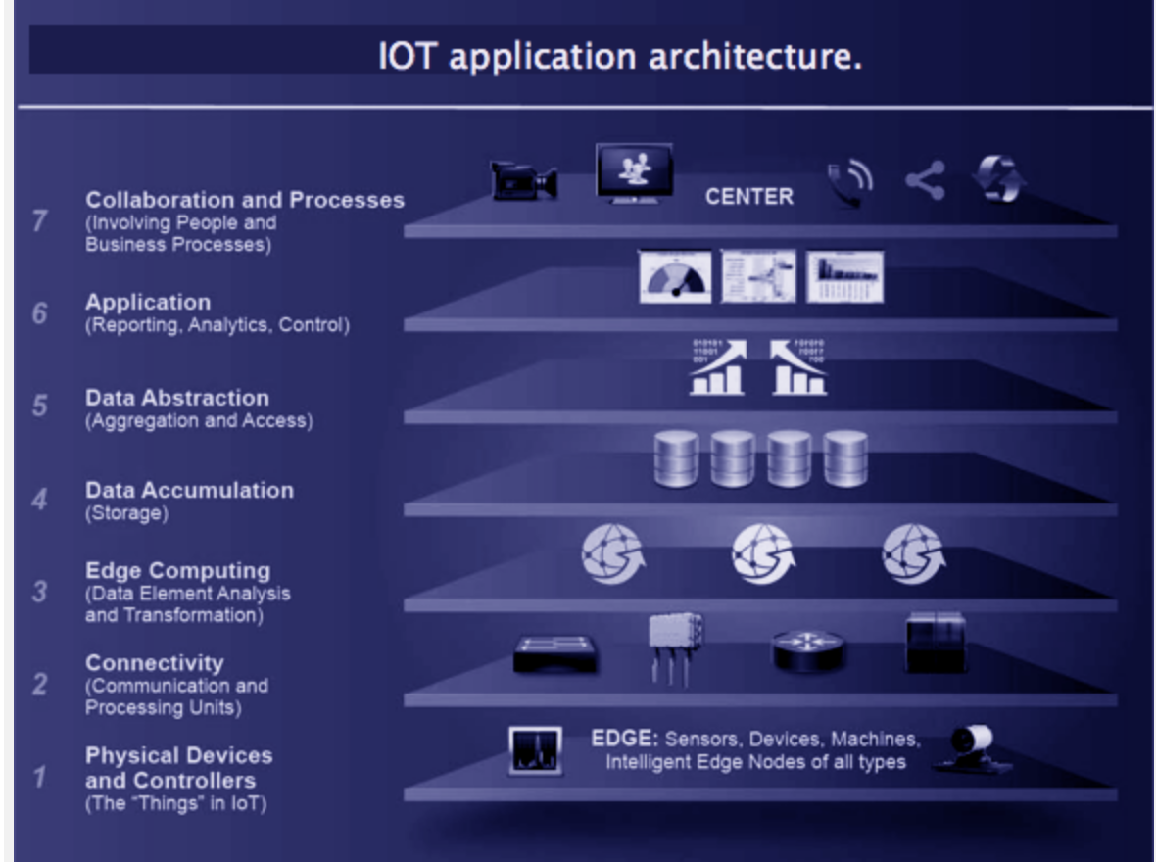
Architecture IoT

Slide 10
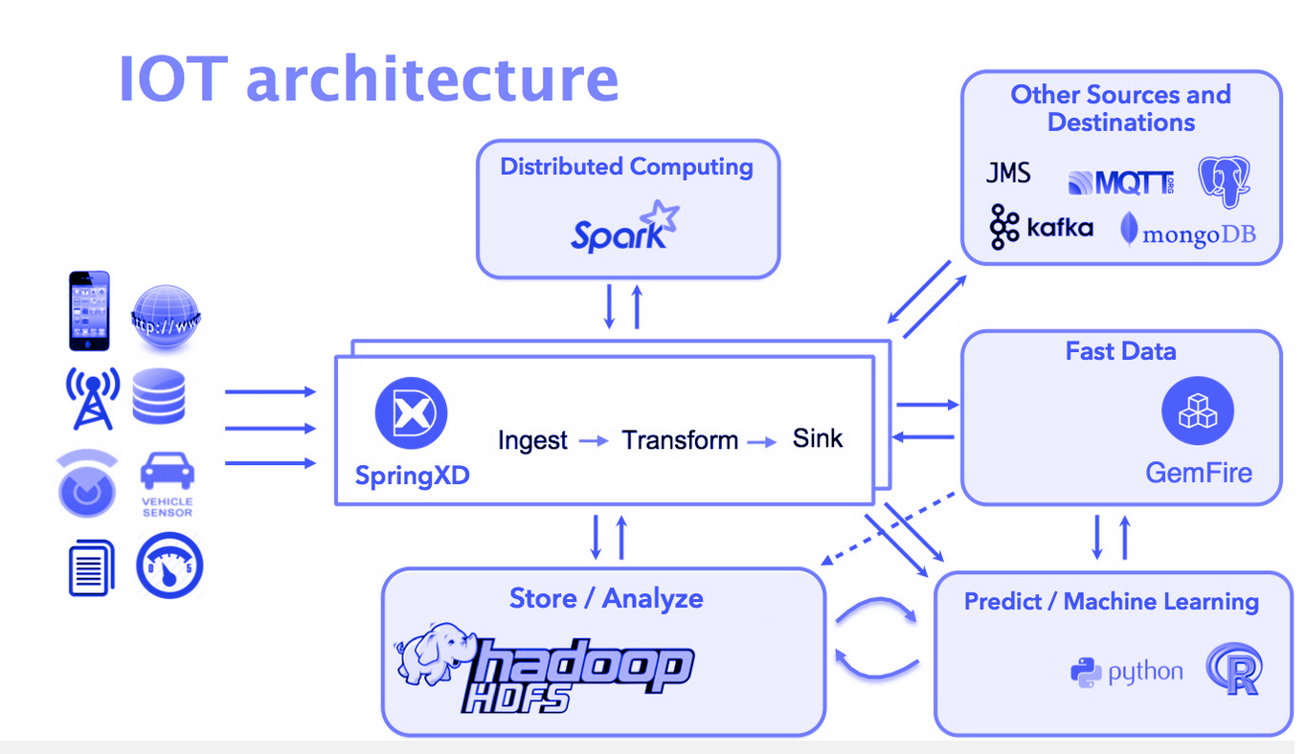
Architecture IoT

Slide 11
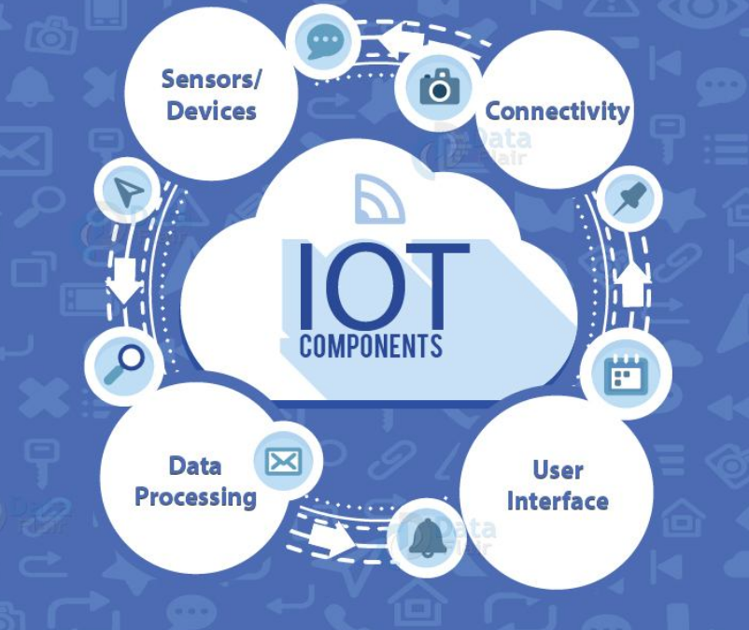
4 composants IoT

Slide 12
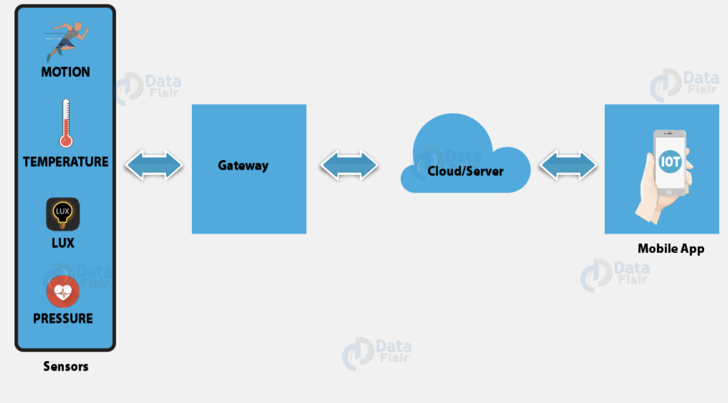
Exemple d’application de santé

Slide 13

1-Capteurs

Slide 14

2-Connectivité

Slide 15
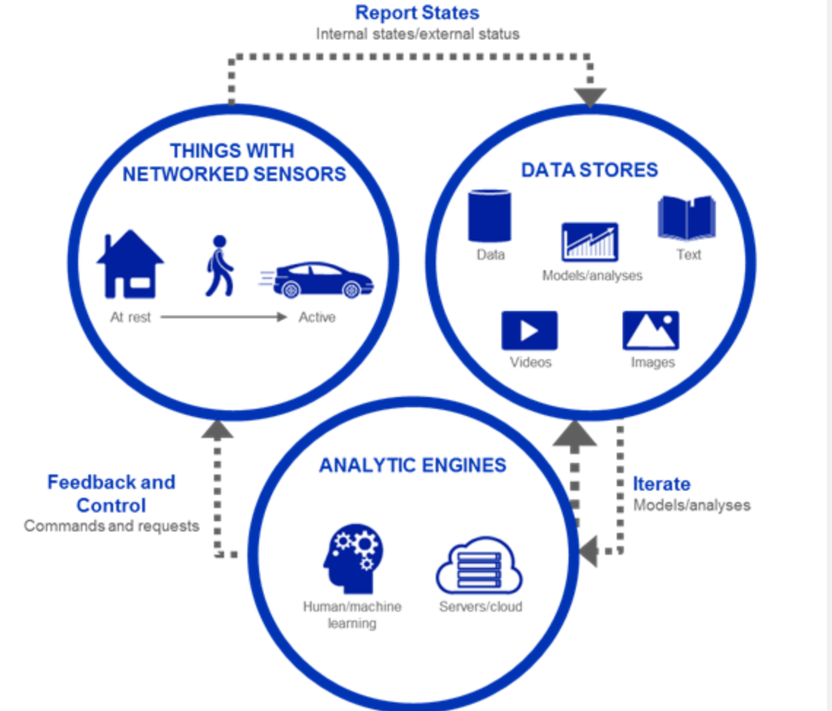
3-Traitement des données

Slide 16
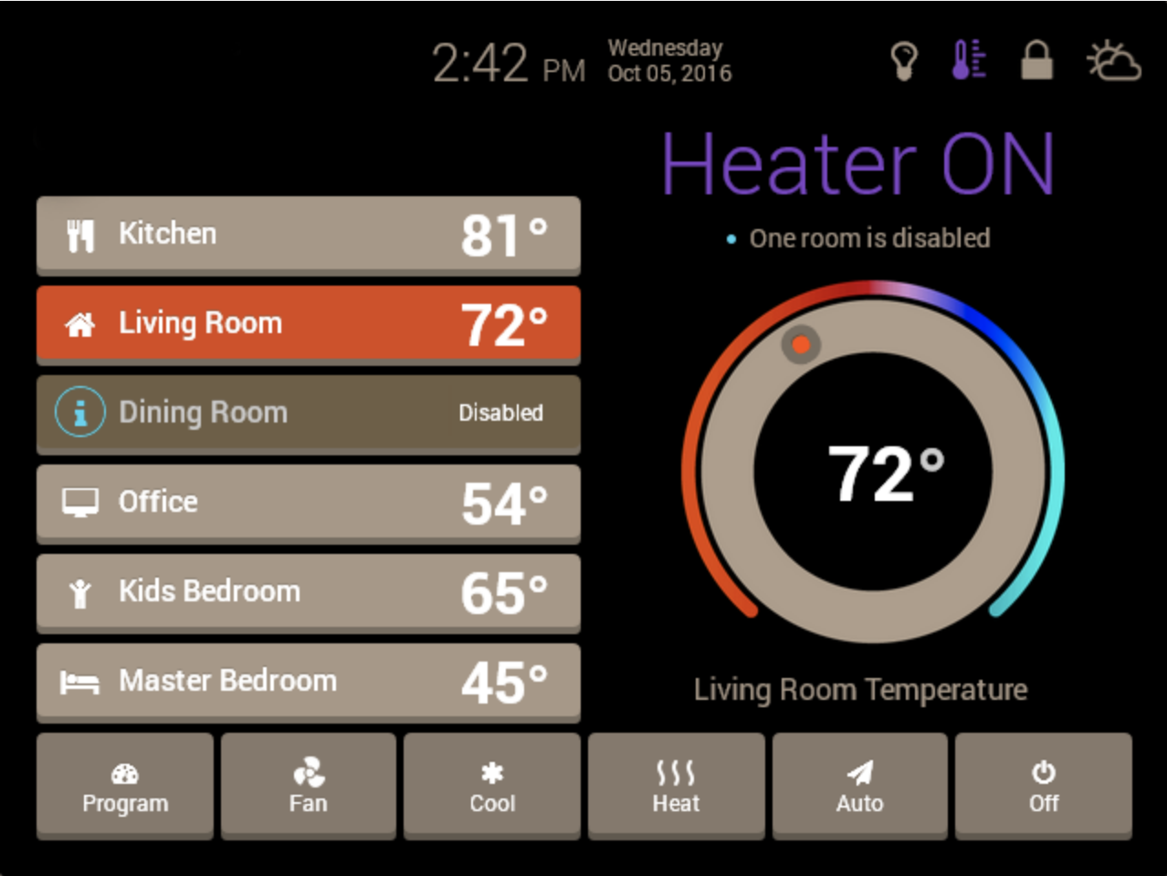
4-Interface Utilisateur

Slide 17
Technologie IoT et Protocls
7 protocoles importants :
Bluetooth
Z-Wave
Wifi
Cellulaire
NFC
LoRaWan
Zigbee

Slide 18
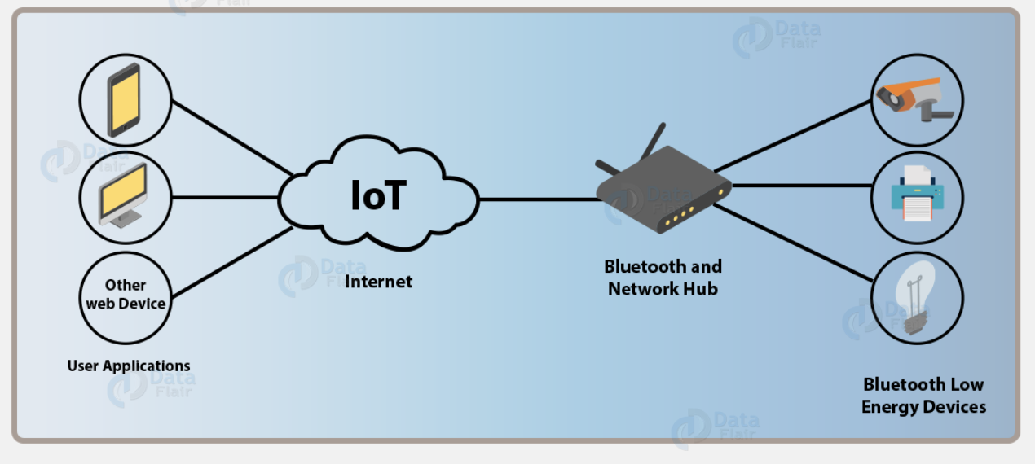
Bluetooth

Slide 19

Z-Wave

Slide 20

wifi

Slide 21
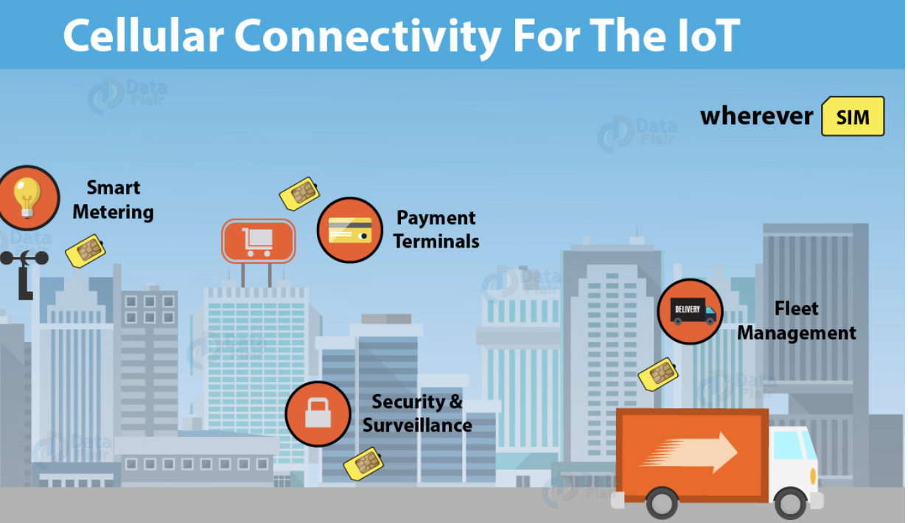
Cellulaire

Slide 22
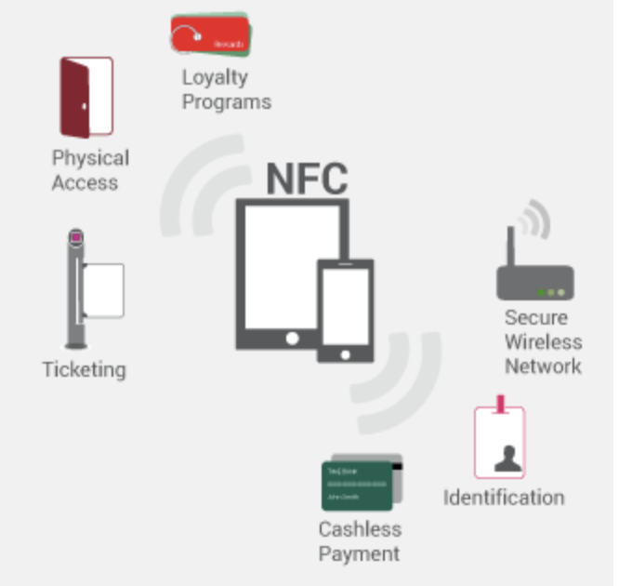
NFC

Slide 23

LoRa Wan

Slide 24
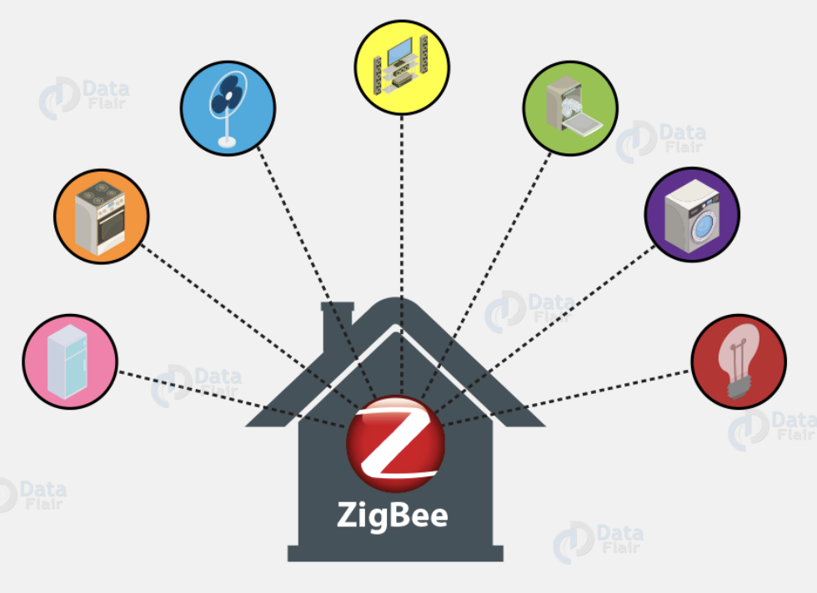
Zigbee

Slide 25
Zigbee
ZigBee Alliance
45+ companies: semiconductor mfrs, IP providers, OEMs, etc.
Defining upper layers of protocol stack: from network to application, including application profiles
First profiles published mid 2003
IEEE 802.15.4 Working Group
Defining lower layers of protocol stack: MAC and PHY

Slide 26
Caractéristiques
Data rates of 250 kbps , 20 kbps and 40kpbs.
Star or Peer-to-Peer operation.
Support for low latency devices.
CSMA-CA channel access.
Dynamic device addressing.
Fully handshaked protocol for transfer reliability.
Low power consumption.
Channels: 16 en 2.4Ghz ; 10 en 900Mhz ; 1 en 890Mhz
Extremely low duty-cycle (<0.1%)

Slide 27
Caractéristiques
802.15.4 is a simple packet data protocol for lightweight wireless networks
Channel Access is via Carrier Sense Multiple Access with collision avoidance and optional time slotting
Message acknowledgement
Optional beacon structure
Target applications
Long battery life, selectable latency for controllers, sensors, remote monitoring and portable electronics
Configured for maximum battery life, has the potential to last as long as the shelf life of most batteries

Slide 28
Types de dispositifs
There are two different device types :
A full function device (FFD)
A reduced function device (RFD)
The FFD can operate in three modes by serving as
Device
Coordinator
PAN coordinator
The RFD can only serve as:
Device

Slide 29
Types de devices
Full function device (FFD)
Any topology
Network coordinator capable
Talks to any other device
Reduced function device (RFD)
Limited to star topology
Cannot become a network coordinator
Talks only to a network coordinator
Very simple implementation

Slide 30
En étoile
Network
Network
coordinator
coordinator
Master/slave
Full Function Device (FFD)
Reduced Function Device (RFD)
Communications Flow

Slide 31
Pair à pair
Point to point
Tree
Full Function Device (FFD)
Communications Flow

Slide 32
Couche Physique
PHY packet fields
Preamble (32 bits) – synchronization
Start of packet delimiter (8 bits) – shall be formatted as “11100101”
PHY header (8 bits) –PSDU length
PSDU (0 to 127 bytes) – data field

Slide 33
Superframe
A superframe is divided into two parts
Inactive: all station sleep
Active:
Active period will be divided into 16 slots
16 slots can further divided into two parts
Contention access period
Contention free period

Slide 34
Superframe
Beacons are used for
starting superframes
synchronizing with other devices
announcing the existence of a PAN
informing pending data in coordinators
In a “beacon-enabled” network,
Devices use the slotted CAMA/CA mechanism to contend for the usage of channels
FFDs which require fixed rates of transmissions can ask for guarantee time slots (GTS) from the coordinator

Slide 35
Duty cycle
Each device will be active for 2^{-(BO-SO)} portion of the time, and sleep for 1-2^{-(BO-SO)} portion of the time

Slide 36
Superframe
The structure of superframes is controlled by two parameters:
beacon order (BO) : decides the length of a superframe
superframe order (SO) : decides the length of the active potion in a superframe
For a beacon-enabled network, the setting of BO and SO should satisfy the relationship 0≦SO≦BO≦14
For channels 11 to 26, the length of a superframe can range from 15.36 msec to 215.7 sec (= 3.5 min).

Slide 37
Slotted CSMA/CA algorithm
In slotted CSMA/CA
The backoff period boundaries of every device in the PAN shall be aligned with the superframe slot boundaries of the PAN coordinator
i.e. the start of first backoff period of each device is aligned with the start of the beacon transmission
The MAC sublayer shall ensure that the PHY layer commences all of its transmissions on the boundary of a backoff period

Slide 38
Slotted CSMA/CA algorithm (cont.)
Each device maintains 3 variables for each transmission attempt
NB: number of times that backoff has been taken in this attempt (if exceeding macMaxCSMABackoff, the attempt fails)
BE: the backoff exponent which is determined by NB
CW: contention window length, the number of clear slots that must be seen after each backoff
always set to 2 and count down to 0 if the channel is sensed to be clear
The design is for some PHY parameters, which require 2 CCA for efficient channel usage.
Battery Life Extension:
designed for very low-power operation, where a node only contends in the first 6 slots

Slide 39
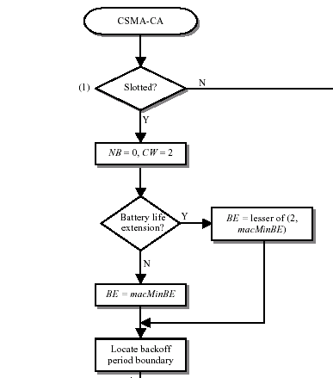
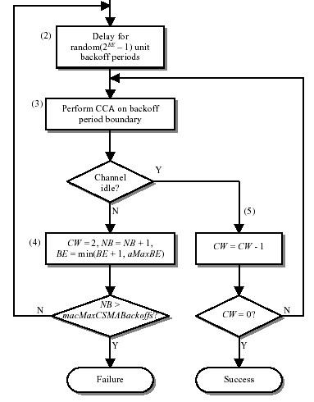
Slotted CSMA/CA (cont.)
need 2 CCA to ensure no collision

Slide 40
Why 2 CCAs to Ensure Collision-Free
Each CCA occurs at the boundary of a backoff slot (= 20 symbols), and each CCA time = 8 symbols.
The standard species that a transmitter node performs the CCA twice in order to protect acknowledgment (ACK).
When an ACK packet is expected, the receiver shall send it after a t_{ACK} time on the backoff boundary
t_{ACK} varies from 12 to 31 symbols
One-time CCA of a transmitter may potentially cause a collision between a newly-transmitted packet and an ACK packet.
(See examples below)

Slide 41
Why 2 CCAs (case 1)
Backoff boundary
Existing session
New transmitter
CCA
Backoff end here
Detect an ACK
New transmitter
CCA
CCA
Backoff end here
Detect an ACK

Slide 42
Why 2 CCAs (Case 2)
Backoff boundary
Existing session
New transmitter
CCA
Backoff end here
Detect an ACK
New transmitter
CCA
Backoff end here
Detect an DATA

Slide 43
Why 2 CCAs (Case 3)
Backoff boundary
Existing session
New transmitter
CCA
CCA
Backoff end here
Detect an ACK
New transmitter
CCA
Backoff end here
Detect a DATA

Slide 44
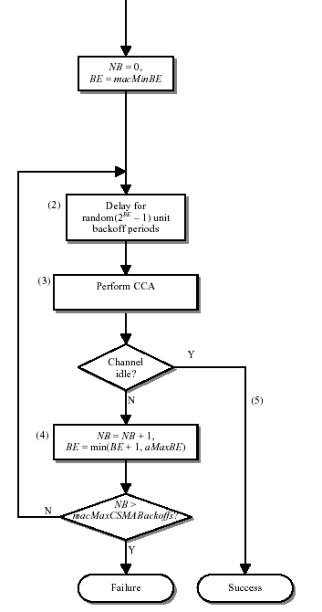
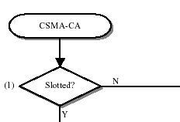
Unslotted CSMA/CA
only one CCA

Slide 45
GTS Concepts (I)
A guaranteed time slot (GTS) allows a device to operate on the channel within a portion of the superframe
A GTS shall only be allocated by the PAN coordinator
The PAN coordinator can allocated up to 7 GTSs at the same time
The PAN coordinator decides whether to allocate GTS based on:
Requirements of the GTS request
The current available capacity in the superframe

Slide 46
GTS Concepts (II)
A GTS can be deallocated
At any time at the discretion of the PAN coordinator or
By the device that originally requested the GTS
A device that has been allocated a GTS may also operate in the CAP
A data frame transmitted in an allocated GTS shall use only short addressing

Slide 47
GTS Concepts (III)
Before GTS starts, the GTS direction shall be specified as either transmit or receive
Each device may request one transmit GTS and/or one receive GTS
A device shall only attempt to allocate and use a GTS if it is currently tracking the beacon
If a device loses synchronization with the PAN coordinator, all its GTS allocations shall be lost
The use of GTSs be an RFD is optional

Slide 48
Association Procedures (1/2)
A device becomes a member of a PAN by associating with its coordinator
Procedures

Slide 49
Association Procedures (2/2)
In IEEE 802.15.4, association results are announced in an indirect fashion.
A coordinator responds to association requests by appending devices’ long addresses in beacon frames
Devices need to send a data request to the coordinator to acquire the association result
After associating to a coordinator, a device will be assigned a 16-bit short address.

